Slide 1
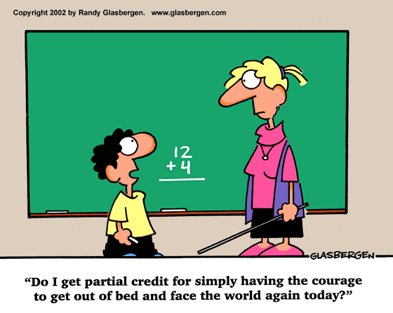
Summary Statistics, Center, Spread, Range, Mean, and Median
Ms. Daniels
Integrated Math 1

Slide 2
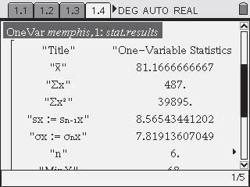
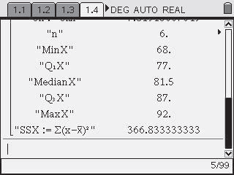
Summary Statistics
Measures of Center (mean and median) and Measures of Spread/Variation (such as range, IQR, SD) are called summary statistics because they help to summarize the information in a distribution or data set.

Slide 3
Spread
The spread of data is how “spread out” the data is or how close together. We use range, Interquartile Range (IQR), and Standard Deviation to measure the spread of a data set.
Today we will just talk about RANGE. (We will talk about IQR and SD in the coming days).

Slide 4
Range
The difference between the maximum value and the minimum value:
$Range=maximum value −minimum value$
Ex 1:
22, 26, 15, 34, 35, 19, 24
Range = 35 – 15 Range = 20

Slide 5
Center
The two most widely used measures of the "center" of the data are the mean (average) and the median.
The median is generally a better measure of the center when there are extreme values or outliers because it is not affected by the precise numerical values of the outliers.
The mean is the most common measure of the center.

Slide 6
Mean
Mean- The sum of the data divided by the number of items in the data set.
Ex 1:
22, 26, 15, 34, 35, 19, 24
22+26+15+34+35+19+24 = 175
$\frac{175}{7}$ = 25
This is most useful when the data has no extreme values.

Slide 7
Median
Median- the middle number of the data ordered from least to greatest, or the mean of the middle two numbers.
12, 42, 17, 25, 36,28, 20
12, 17, 20, 25, 28, 36, 42
Ex 1:
Ex 2:
3, 5, 6, 9, 13, 16
$$6+9=15$$
$$15÷2=7.5$$
This is most useful when the data has extreme values and there are no big gaps in the middle of the data.

Slide 8
Unit 1 Lesson 1 Inv. 2 pg. 85 #3
a.) What is the position of the median when there are 40 values? Find the median of this set of values. Locate the median on the horizontal axis of the histogram.
There are 40 values, so the median occurs at position (40 +1) / 2, OR halfway between the 20th and 21st values, which are 4 and 5. The median is 4.5 and is located on the boundary between the 4 bar and the 5 bar.

Slide 9
Unit 1 Lesson 1 Inv. 2 pg. 85 #3
b.) Find the area of the bars to the left of the median. Find the area of the bars to the right of the median. How can you use area to estimate the median from a histogram?
The area of the bars to the left of median is 20. The area of the bars to the right of median is 20. Estimate the value that divides the total area of the bars in half. (Note- doesn’t work this way- doesn’t always have two equal halves.)

Slide 10
Unit 1 Lesson 1 Inv. 2 pg. 85 #4
Students may think in terms of frequency bars. More than half of the data are on the left of the hand, so the median is to the left of the hand. Alternatively, the total area of the bars to the left of the hand is greater than the total area of the bars to the right of the hand, so the median is to the left of the hand.

Slide 11
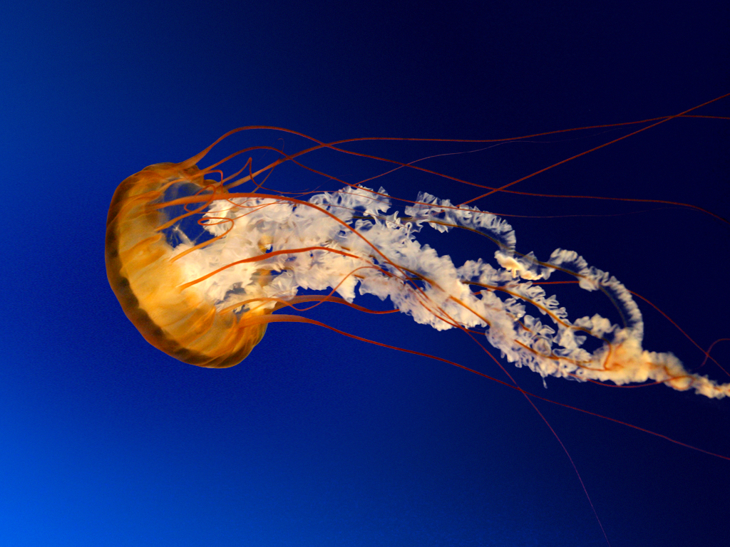
Boxplots, IQR, Range, Outliers, Minimum/ Maximum

Slide 12
Measure of Variation/Variability
Used to describe the distribution of the data; similar to spread;

Slide 13
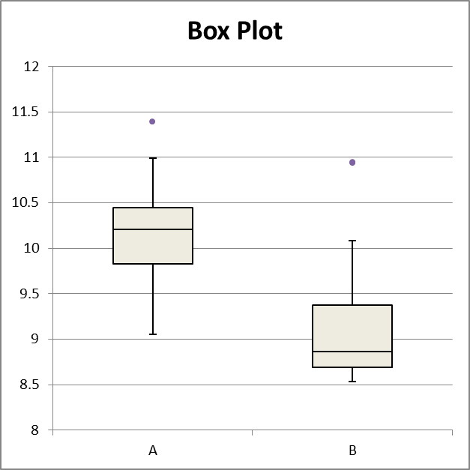
Box and Whisker Plots
Box plots are most useful when the distribution is skewed or has outliers or if you want to compare two or more distributions or sets of data.

Slide 14
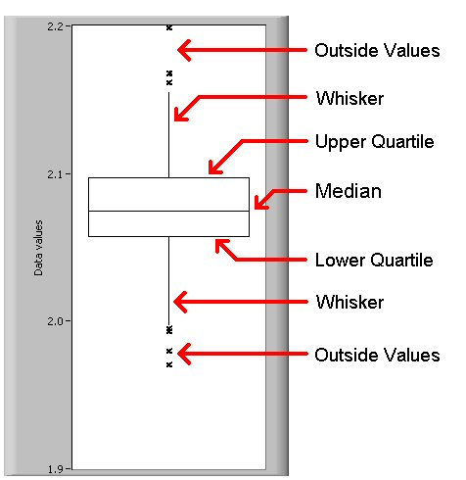
Quartiles
values that divide the data into four equal parts, each representing 25% of the data.

Slide 15
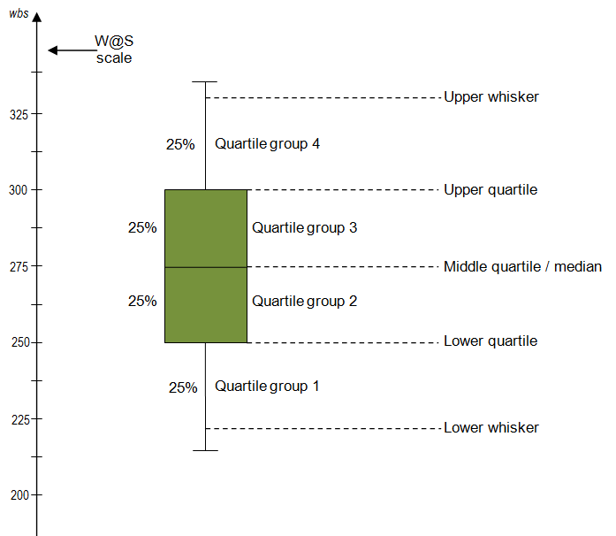

Slide 16
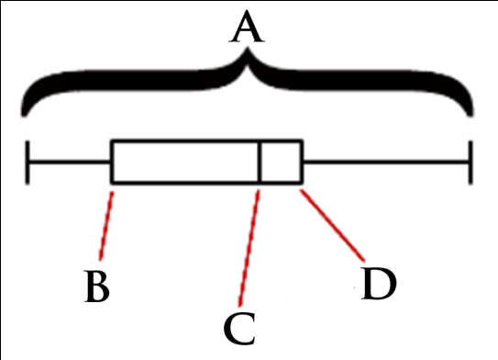
Lower Quartile
The median of the lower half of a set of data. (LQ)
-(25% of the data is below this number and 75% of the data is above this number)

Slide 17
Upper Quartile
The median of the upper half of a set of data. (UQ)
-(25% of the data is above this number, 75% of the data is below this number)

Slide 18
Range
The difference between the maximum value and the minimum value:
$Range=maximum value −minimum value$
Ex 1:
22, 26, 15, 34, 35, 19, 24
Range = 35 – 15 Range = 20

Slide 19
Interquartile Range (IQR)
- The range of the middle half of the data; the difference between the upper quartile and lower quartile. (IQR)
Upper Quartile – Lower Quartile = IQR

Slide 20
Minimum Value
- The smallest value in the data set.
Maximum Value
- The largest value in the data set.
Example:
4, 7, 9, 14, 17, 26, 31, 42
Maximum
Minimum

Slide 21
Standard Deviation
Standard deviation is a distance that is used to describe the variability in a distribution.
http://www.mathsisfun.com/data/standard-deviation.html

Slide 22
Standard Deviation pt. 2
http://www.mathsisfun.com/data/standard-deviation-formulas.html

Slide 23
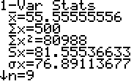
How to find SD in your Calc:
First, enter your sets of data into L1, L2, or both.
STAT
ENTER
Once you’ve entered your data we need to calculate the summary statistics, or the “1-Variable Statistics.”
STAT
ENTER
Arrow to the right to highlight “CALC”
Your calculator screen should now look like the picture below. If you want to calculate for $L_{2}$ instead of $L_{1}$, you need to put your cursor on $L_{1}$ and press
2nd
2
Then arrow down to “Calculate” and press
ENTER
“Sx” (circled in red) is the standard deviation we will use at this level.

Slide 24
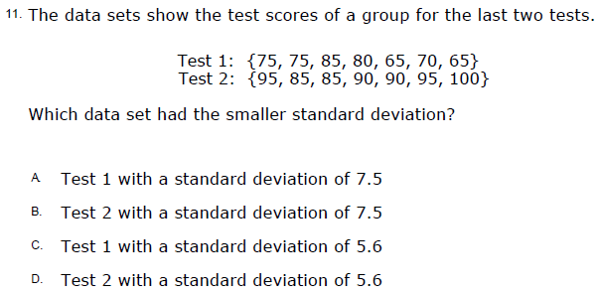
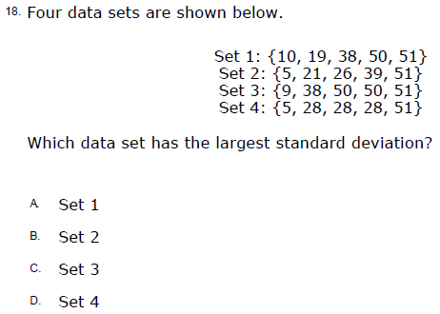
Standard Deviation Practice

Slide 25
Example 1: Find the Upper Quartile and Lower Quartile of the data set and the IQR:
12.9, 12.9, 13.1, 13.3, 13.4, 14.2, 14.4, 14.9, 14.9, 15.8
1.)First we must make sure that the numbers are listed from least to greatest. Next, we find the median of the data. This will separate the data into an upper part and a lower part.
$↓$ Median$↓$
12.9, 12.9, 13.1, 13.3, 13.4 14.2, 14.4, 14.9, 14.9, 15.8
Median of the $↓$ lower half of the data
12.9, 12.9, 13.1 13.3, 13.4
Median of the $↓$ upper half of data
14.2, 14.4, 14.9 14.9, 15.8
So the Lower Quartile (LQ) of this data set is: 13.1
So the Upper Quartile (UQ) of this data set is: 14.9

Slide 26
Now find the IQR:
Upper Quartile – Lower Quartile = IQR
$$14.9−13.1=1.8$$

Slide 27
Your Turn!
Find the LQ, UQ, and IQR:
2, 24, 6, 13, 8, 6, 11, 4
(Reorder!) 2, 4, 6, 6, 8, 11, 13, 24
Median: $6+8=14÷2=7$
LQ: $4+6=10÷2=5$
UQ: $11+13=24÷2=12$
IQR:$12−5=7$

Slide 28
Outliers- Data that is 1.5 times more than the value of the Interquartile Range (IQR) beyond the quartiles.
Example 3: Find any outliers for the data set.
1.)First must find the IQR of our data set. {Thus, we must we must order data, find median, LQ and UQ}
2, 3, 5, 7, 9, 12, 16, 21, 43
Median = 9
Lower Quartile: $3+5=8÷2=4$
Upper Quartile: $16+21=37÷2=18.5$
IQR:$18.5−4=14.5$

Slide 29
2.) Multiply the IQR, 14.5, by 1.5.
$$14.5×1.5=21.75$$
To find the limits for the outliers, add 21.75 to the upper quartile, subtract 21.75 to the lower quartile.
3.) Add the product, 21.75, to the upper quartile to find the upper limit
18.5 + 21.75 = 40.25
4 – 21.75 = –17.25
The limits for the outliers are –17.25 and 40.25. Since 43 is in our data set and is larger than the upper limit, it is an outlier for our data set.

Slide 30
Your Turn Again!
6, 15, 27, 28, 29, 30, 32, 38, 40, 59, 63
Median: 30
LQ: 27
UQ: 40
IQR: $40−27=13$ $×1.5=$19.5
Outlier Limits:
Lower Limit:$27−19.5=7.5$
Upper Limit: 40 + 19.5 = 59.5
Any data in our data set that is less than 7.5 or greater than 59.5 is an outlier for our data set.
The outliers for this data set are: 6 and 63.

Slide 31
Extra Practice!
56, 58, 57, 86, 43, 35, 76, 54, 91, 130, 42, 59
Median: 57.5
LQ: 48.5
UQ: 81
IQR: $81−48.5=32.5$ $×1.5=48$.75
Outlier Limits:
Lower Limit:$48.5−48.75=−.25$
Upper Limit: 81 + 48.75 = 129.75
Any data in our data set that is less than -.25 or greater than 129.75 is an outlier for our data set.
The outliers for this data set are: 130.

Slide 32
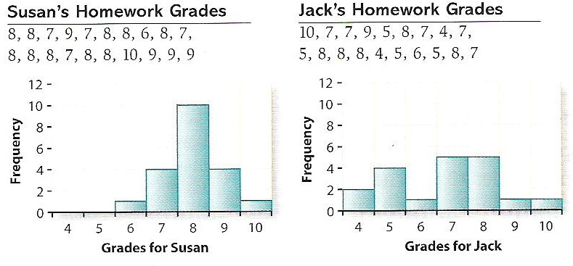
Unit 2: Lesson 2: Inv.1: pg. 106 #6
Find 5# summary & Box Plot info with Calculator. (including SD)

Slide 33
Unit 2: Lesson 2: Inv.1: pg. 106 #6
a.) Which of the students has greater variability in his or her grades?
Jack’s grades are more spread out. His grades vary from 4 through 10, while Susan’s grades only vary from 6 through 10. But aside from looking at just the extreme values, most of the grades for Jack are away from the center of his distribution, while those for Susan tend to be lumped in the middle.

Slide 34
Unit 2: Lesson 2: Inv.1: pg. 106 #6
B-C.) Use the calculator to find the median, Upper and Lower Quartiles for Jack’s and Susan’s grades.
Susan:
LQ: 7.5
Med: 8
UQ: 8.5
Jack:
LQ: 5
Med: 7
UQ: 8

Slide 35
Unit 2: Lesson 2: Inv.2: pg. 109 #2
Use calculator to find range and IQR for following set of data.
1,2 ,3, 4,5, 6, 70
a.) Remove the outlier 70. Find range & IQR of data. What changed more?
b.) Which is more resistant to outliers? Why?
c.) Why is the interquartile range more informative than the range as a measure of variability?

Slide 36
Unit 2: Lesson 2: Inv.2: pg. 109 #3
a.) Is the distribution skewed to the left or to the right, or is it symmetric? Explain.

Slide 37
Unit 2: Lesson 2: Inv.2: pg. 110 #4
a.) Make a box plot for Susan’s homework grades.
b.) Why do the plots for Maria and Tran have no whiskers at the upper end?

Slide 38
Unit 2: Lesson 2: Inv.2: pg. 110 #4
c.) Why is the lower whisker on Gia’s box plot so long? Does this mean there are more grades for Gia in that whisker than in the shorter whisker?

Slide 39
Unit 2: Lesson 2: Inv.2: pg. 110 #4
d.) Which distribution is the most symmetric? Which distributions are skewed to the left?

Slide 40
Unit 2: Lesson 2: Inv.2: pg. 110 #4
e.) Looking at the box plots, which of the 5 students has the lowest median grade?

Slide 41
Unit 2: Lesson 2: Inv.2: pg. 110 #4
f.) i. Does the student with the smallest IQR also have the smallest range?
ii. Does the student with the largest IQR also have the largest range?

